Slide 1

DONE BY:
Sundaram A

Slide 2

Problem
Customer churn is a big problem for telecommunications companies and It is one of the important concerns for the Telecom Industry
Indeed, their annual churn rates are usually higher than 10%. For that reason, they develop strategies to keep as many clients as possible.
It costs 5 to 10 times more to acquire a new customer than to retain an existing one, That’s why customer retention has now become even more important than customer acquisition

Slide 3
Objectives
The main objective of this project is to model churn probability, conditioned on the customer features
This is a classification project (ie) to find a probability of churn and loyal customers
The goal here is to model churn probability, conditioned on the customer features.
Develop strategies to keep as many clients as possible.
Finding factors that influence the churn.
Helps you predict and thus reduce future churn.
Applying strategies and different plans to minimize the churn

Slide 4
DATASET:
Each row corresponds to a client of the telecommunications company for whom it has collected information about the type of plan they have contracted, the minutes they have talked and the charged they have paid every month.
● State: Categorical, for the 51 states and the District of Columbia.
● Area.code
● account.length: how long the account has been active.
● voice.plan: yes or no, voicemail plan.
● voice.messages: number of voicemail messages.
● intl.plan: yes or no, international plan.
● intl.mins: minutes customer used service to make international calls.
● intl.calls: total number of international calls.
● intl.charge: total international charge.
● day.mins: minutes customer used service during the day.
● day.calls: total number of calls during the day.
● day.charge: total charge during the day.
● eve.mins: minutes customer used service during the evening.
● eve.calls: total number of calls during the evening.
● eve.charge: total charge during the evening.
● night.mins: minutes customer used service during the night.
● night.calls: total number of calls during the night.
● night.charge: total charge during the night.
● customer.calls: number of calls to customer service.
● churn: Categorical, yes or no. Indicator of whether the customer has left the company (yes or no).

Slide 5
Data Preprocessing
Data consists of 5000 rows and 20 columns.
We observe datatype of the attributes where we found 7 attributes have object data type.
The datatype of the feature – ‘day.charge’ & ‘eve.mins’ were converted to float datatype.
We checked for duplicated values and there were no duplicated values.
We have dropped unnecessary columns ‘Unnamed0’.

Slide 6
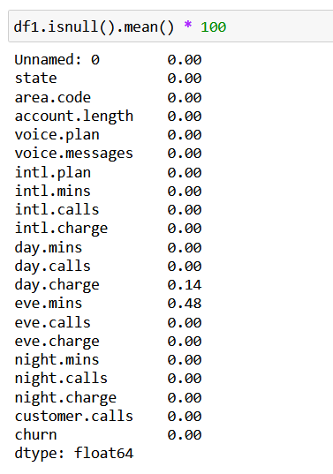
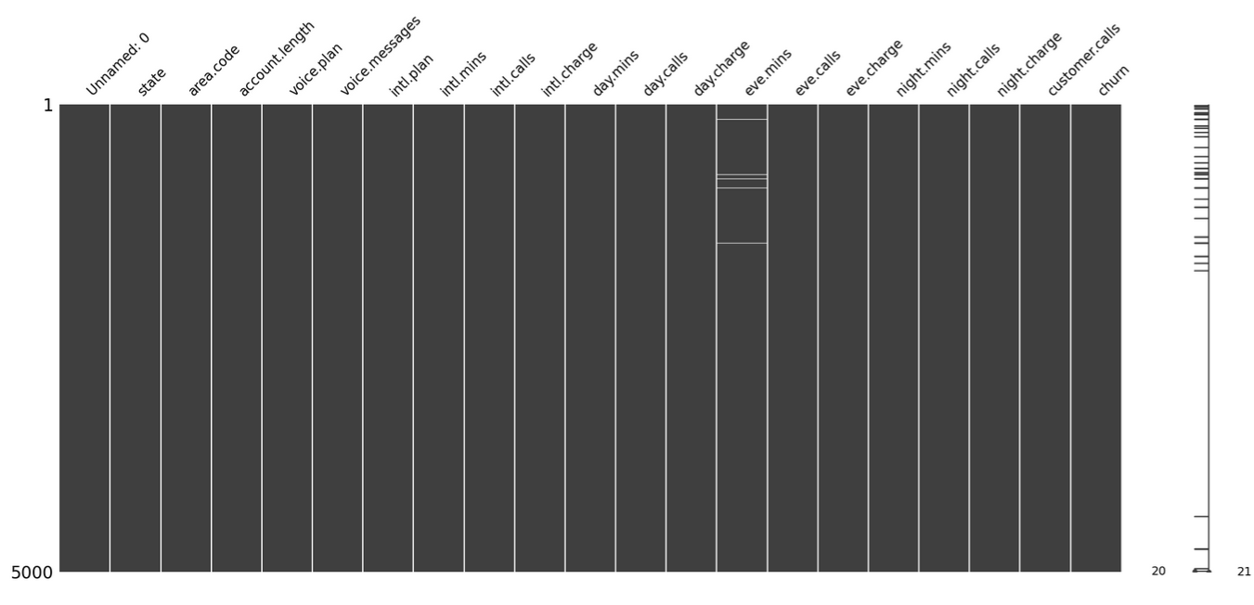
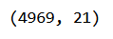
Missing values
Observation : we can see that the percentage of null values is very low (Day.charge – 14%, Eve.mins – 48%) so we can either remove or replace it with the mean of the respective column
In 5000 records, 30 records having NAN Values. It is less than 1% so we can drop those missing value. It will not have any impact on this data set

Slide 7
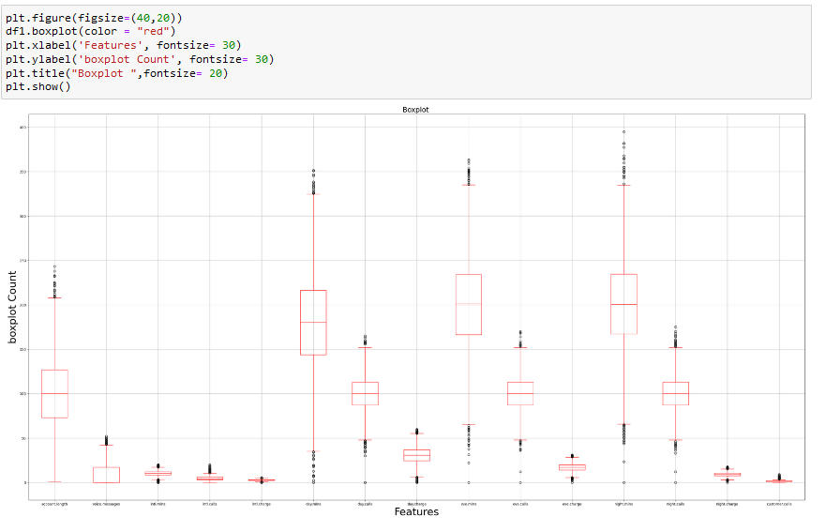
Outliers - Detection
Each features have outliers, but in this problem we cannot cap /Drop outliers. Because they play an important role in prediction

Slide 8
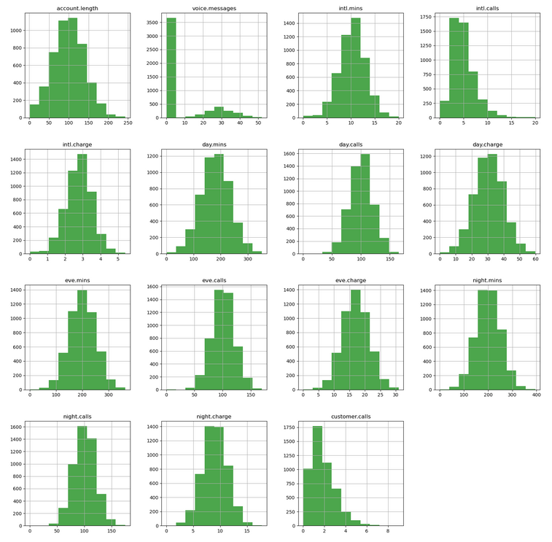
Distribution
In given data set, apart from Voice message others are normally distributed.
Most of the observations are lying at the center

Slide 9
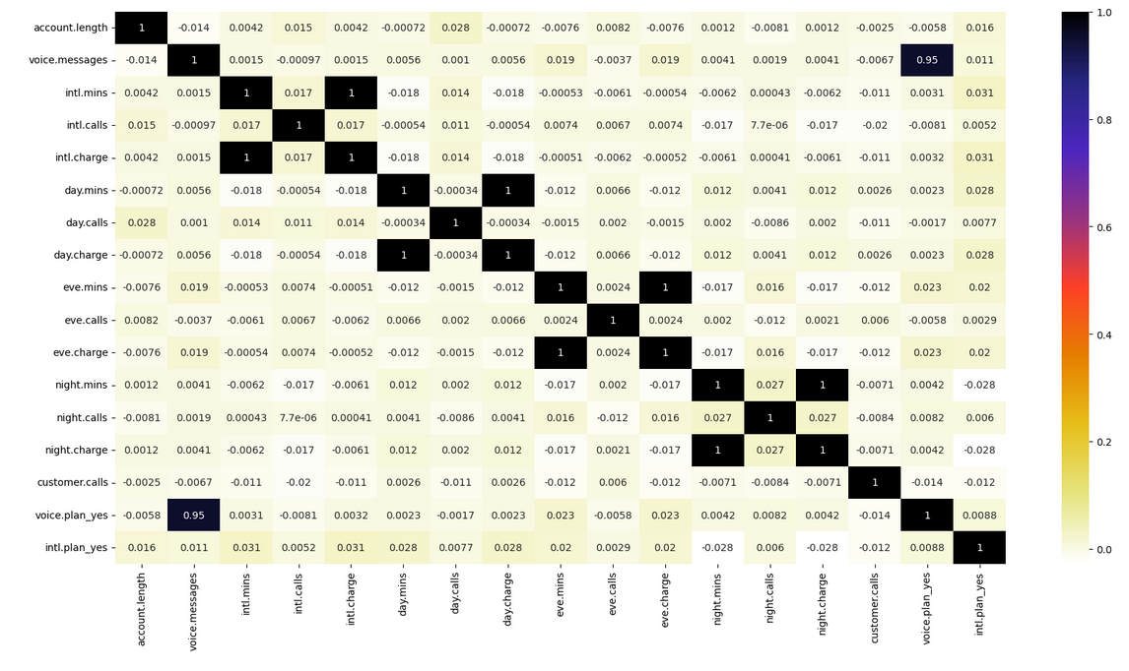
Correlation – Heat plot
There is high collinearity between mins and charges.
Other data are also correlated
Intl charge vs Intl mins, Day charge vs Day mins,
Eve charge vs eve mins,
Night charge vs Night mins, are highly correlated

Slide 10
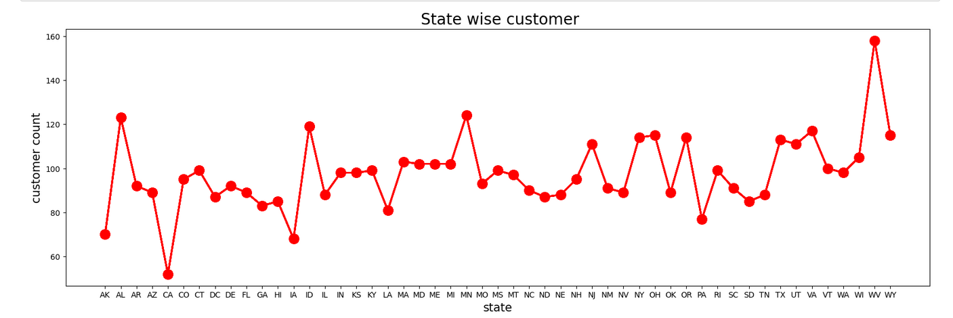
State-wise Customer distribution
This is State-wise customer distribution chart
WV(West Virginia) has high customer distribution and
CA(California) has low customer distribution
STATE
STATE

Slide 11
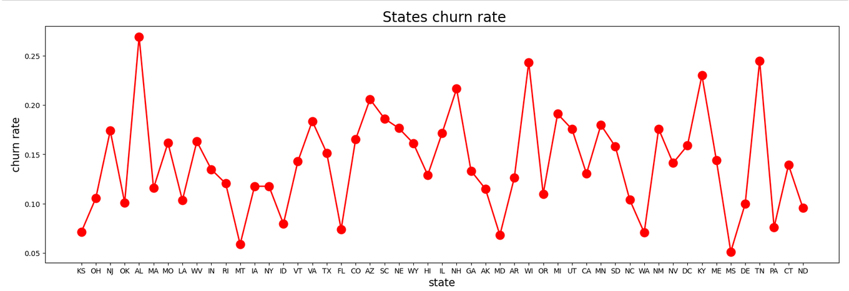
Statewise churn rate
This figure shows the churning rate among all 51 countries from that we can see lowest churning rate state i.e MS(Mississippi) at 0.05% and highest churning rate state i.e AL(Alabama) at above 0.25%.

Slide 12
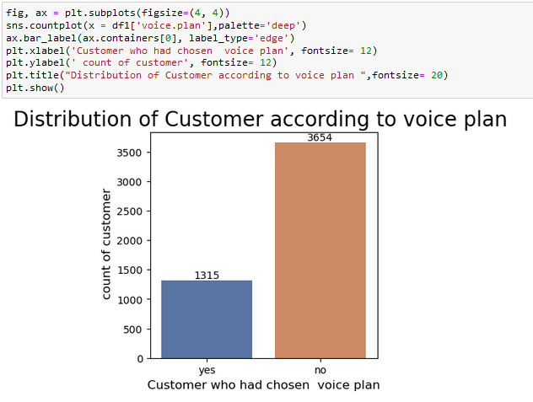
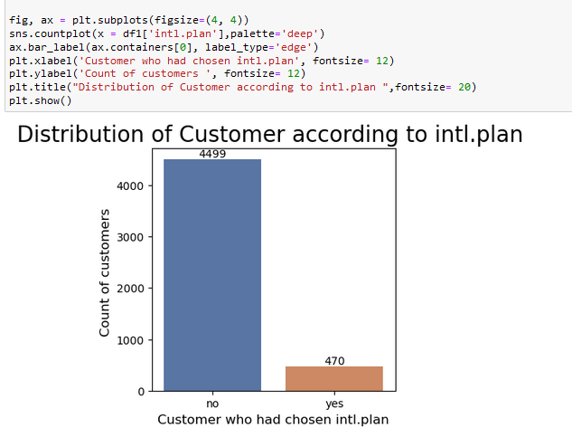
No of customers according to Voice plan and Intl Plan
Customers who opt for voice plan is comparatively higher than customers opting for Intl Plan

Slide 13
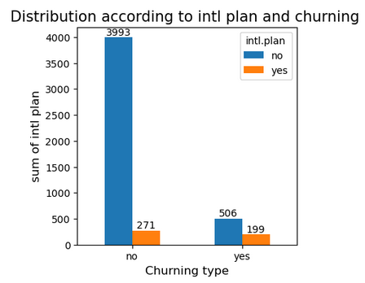
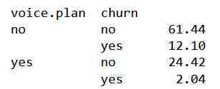
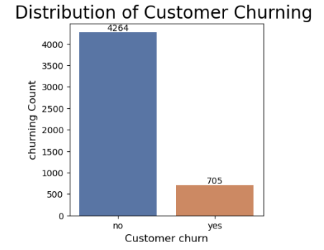
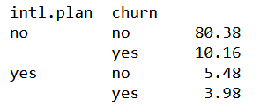
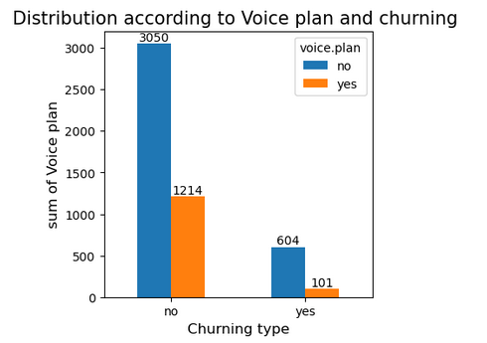
Number of customers Churning
Total customer churn count is comparatively less.
Customers who have intl plan churns more (>40%) when compared to voice plan.

Slide 14
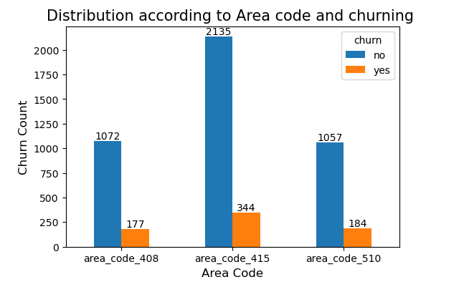
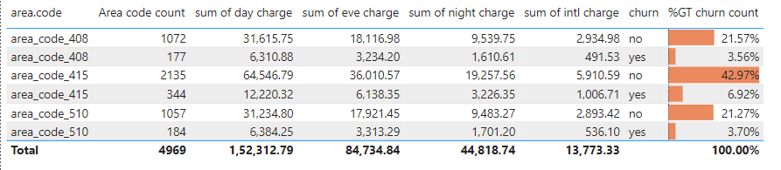
Area code – churning rate
From observation, Area code 415 has more customers and it has more churning count also.
Other 2 area code has more or less same no of customers and chunring rate.

Slide 15
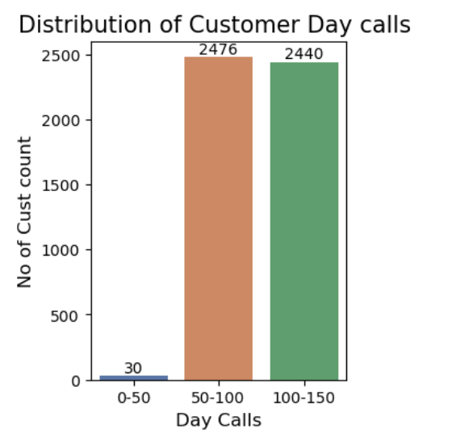
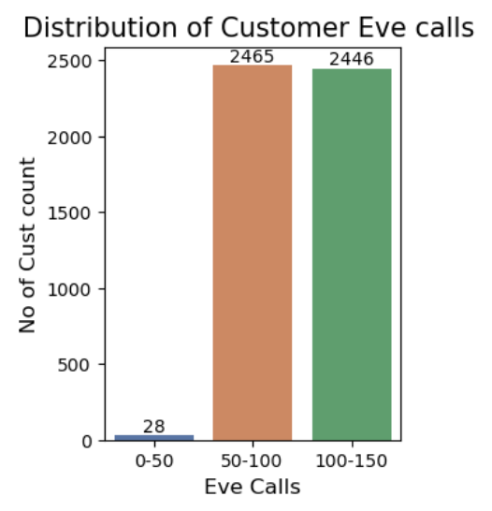
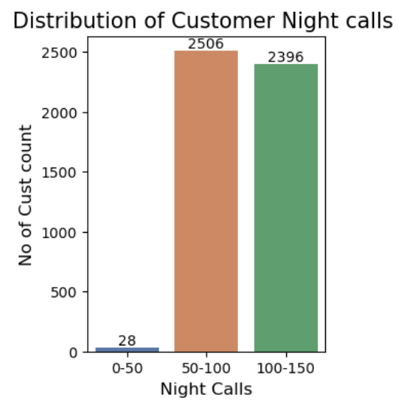
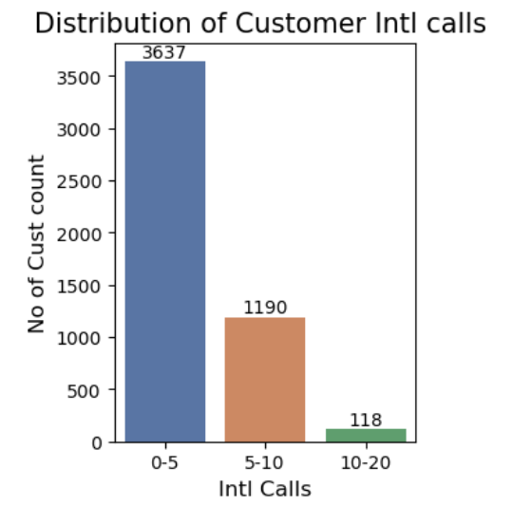
Distribution of customers according to Calls
This indicates that our customers uses local calls(Day, Eve, Night) more when compared with International calls.
All Local calls are equally used.

Slide 16
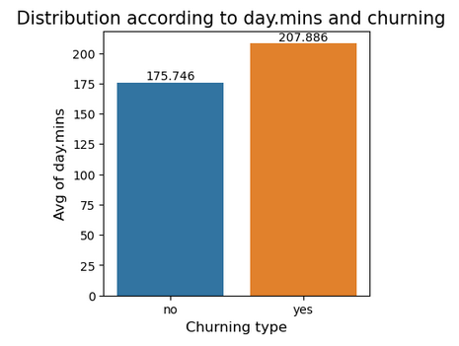
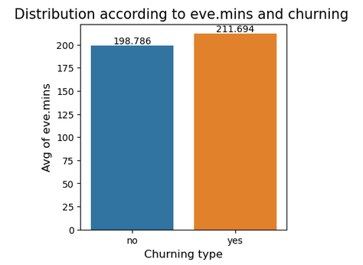
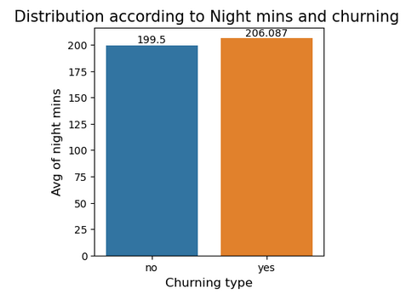
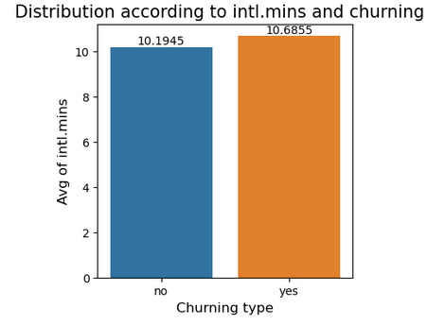
Mins-wise churn rate
Churning rate is greater in customers who spends more mins in calls (day, eve,nyt,intl).
Hence they may pay higher charges for it.

Slide 17
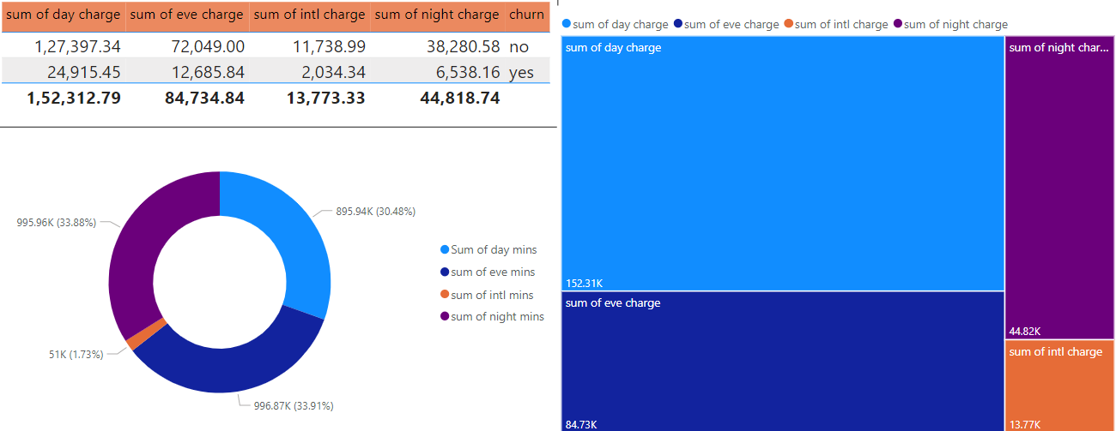
Sum of charges and sum of mins
More customers are spending more on Day Charge.
Customers spend more mins in night calls when compared with other calls.

Slide 18
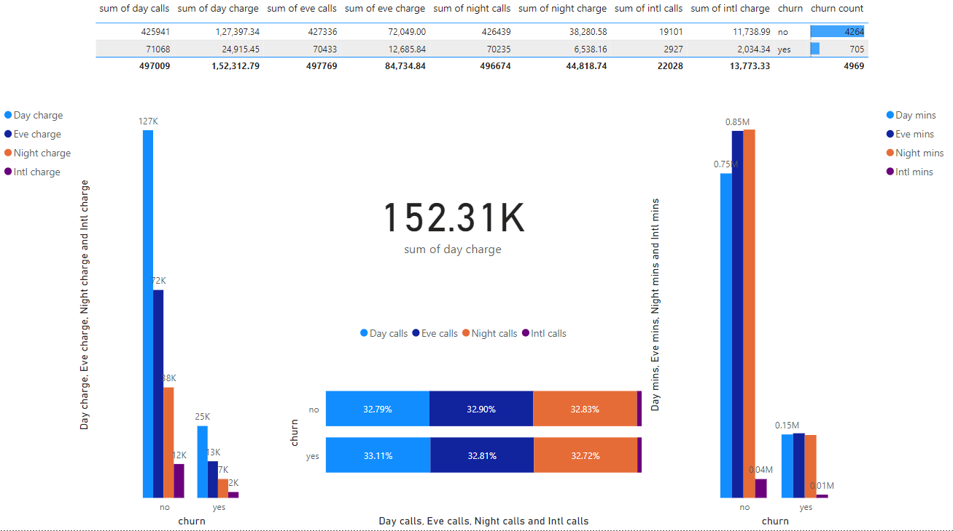
Day vs eve vs night vs Intl
Comparing all charges – Customers who pays Day charge is higher when compared.
By comparing mins spend in each calls – Customers spend more mins in night calls.
Sum of calls are equally distributed

Slide 19
INSIGHTS

Slide 20
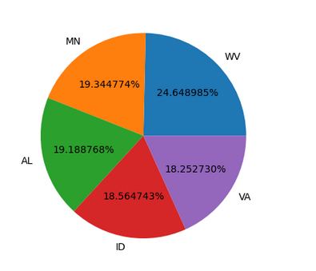
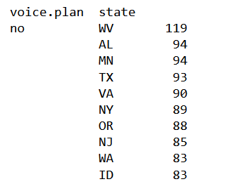
Top 5 states of Customers
Top states that not uses Voice plan
Top states which have high no of customers are the least no of users of Voice plan.
WV
AL
MN
VA
ID
WV
AL
MN
ID
VA

Slide 21
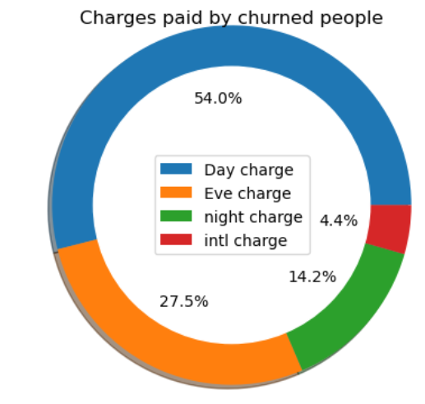
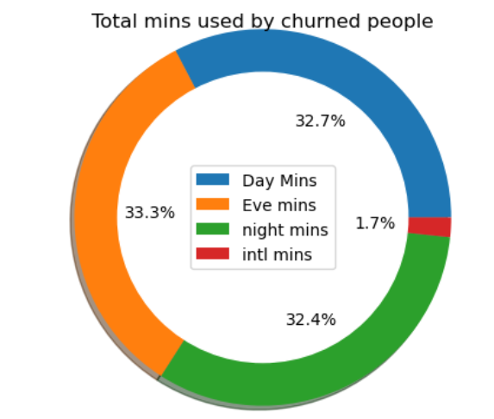
Total Charges and mins spend by churned customer
These are filtered data of churned customers whose usage of day calls are comparatively less to eve and night calls BUT they pay high charge for day
More no of people are churning because of charges. So the company could provide separate plans to avoid churning

Slide 22
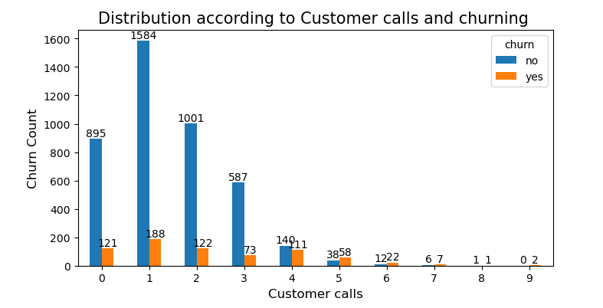
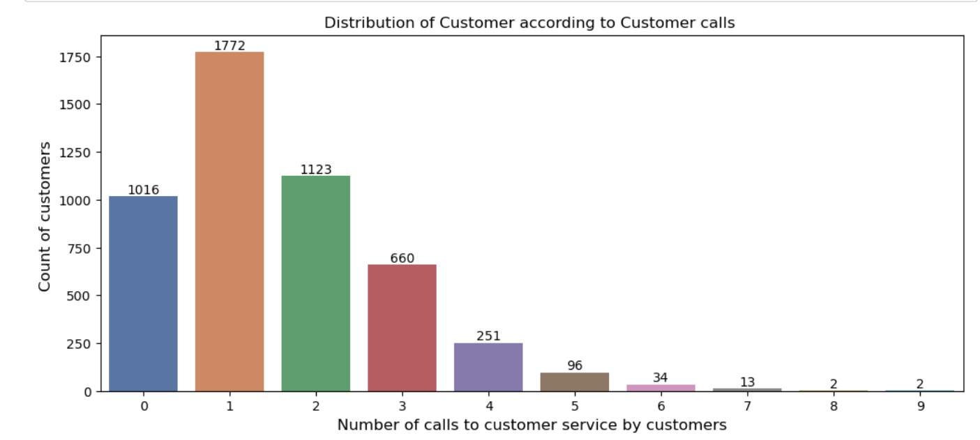
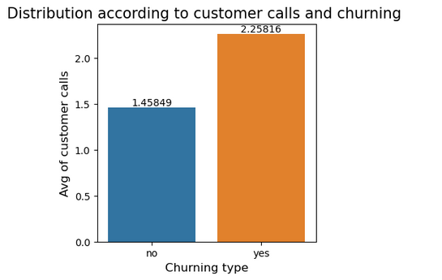
Churn rate according to customer calls
Customers who calls customer service is higher that those who are not calling customer service.
Churning rate is higher in Customer who calls for customer service.
Customer who are calling 5th and 6th time for customer service are churning more.

Slide 23
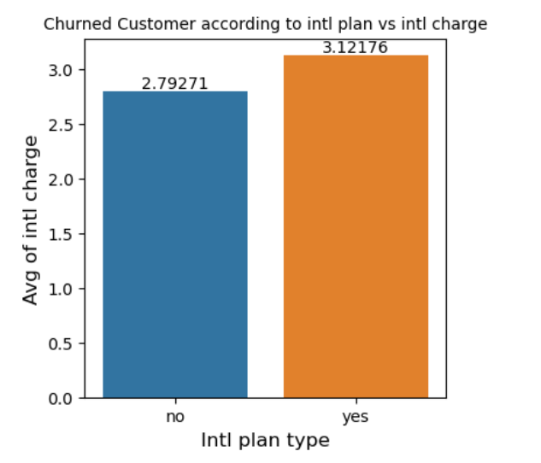
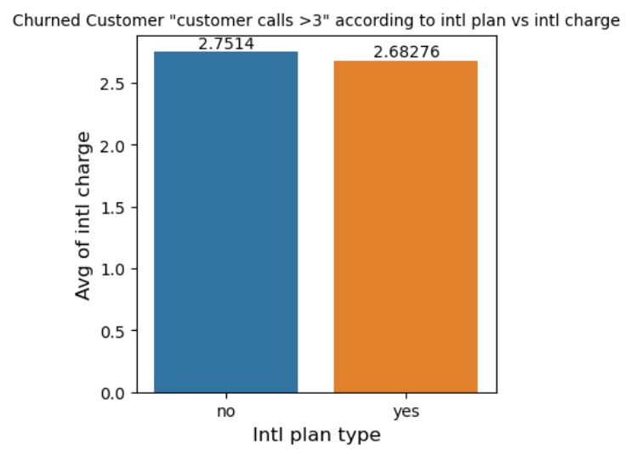
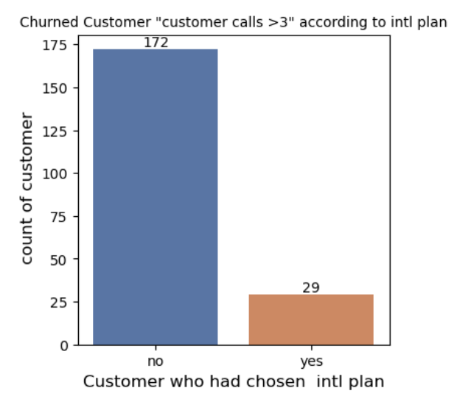
Churned Customers with calls > 3 customer calls
The filtered data of customers who calls customer service more than 3 times shows that they pay intl chares even though they didn’t opt for intl plan
From filtered data of churned customers shows that most of customers haven’t opted for intl plan but they pay charges for it
TOTAL CHURNED
Customer call > 3
Count of cust calls >3

Slide 24
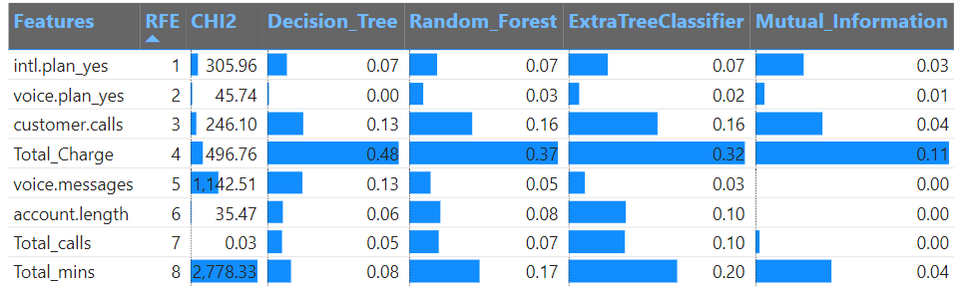
Feature Selection
We have created new columns ‘Total _charge’ by adding all the charges, ‘Total_calls’ by adding calls and ‘Total_mins’ by adding all the mins and checked for different types of Feature selection (RFE, Chi2, Decision tree, Random forest, Extra Tree classifier, Mutual information) and found that Total charge, total mins and customer calls are most significant feature.
We done this column reduction which will be useful in deployment.
We have tried different models with these new features, we did not get good accuracy (Precision, recall and F1 score were less).

Slide 25
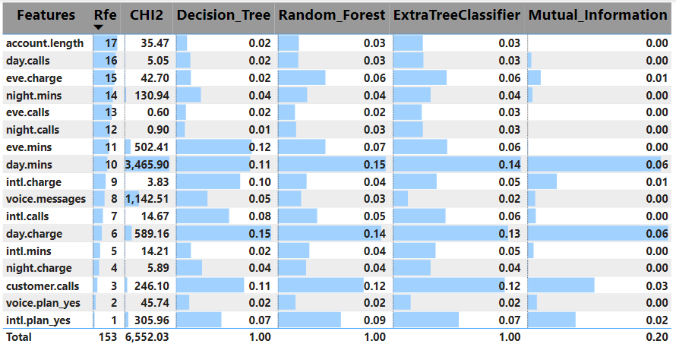
Feature selection – with Original dataset
For feature selection we used RFE(Recursive feature elimination), CHI2, Decision_Tree, Random forest, Extratree_Classifier and Mutual information were used.
In comparison with all, important features are day mins, Day charge, Customer calls and Intl calls.
But in reference with RFE→ Intl plan, voice plan and customercalls are more important
The least important is Account length, day calls, Eve charge and calls, night charge and calls

Slide 26
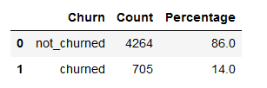
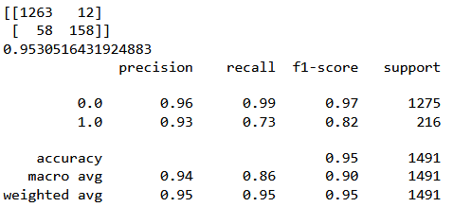
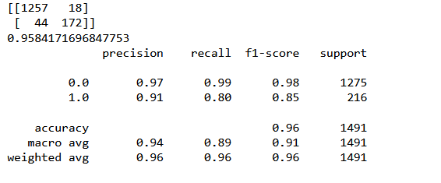
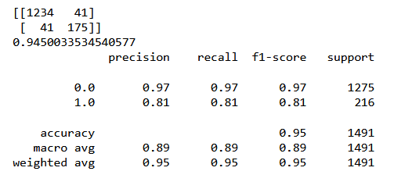
Difference between OS, Smote and Normal data
Normal dataset: RF
AFTER Oversampling: RF
AFTER SMOTE: RF

Slide 27
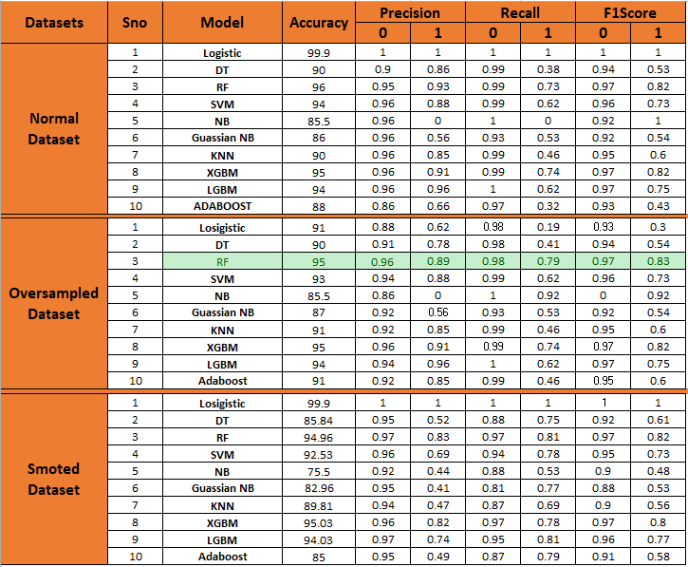
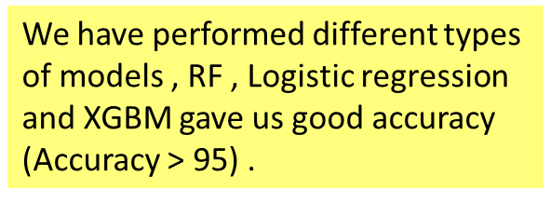
Model Accuracy for Normal, Smoted and Oversampled data
DEPLOYED MODEL ➔Oversampled: RF

Slide 28
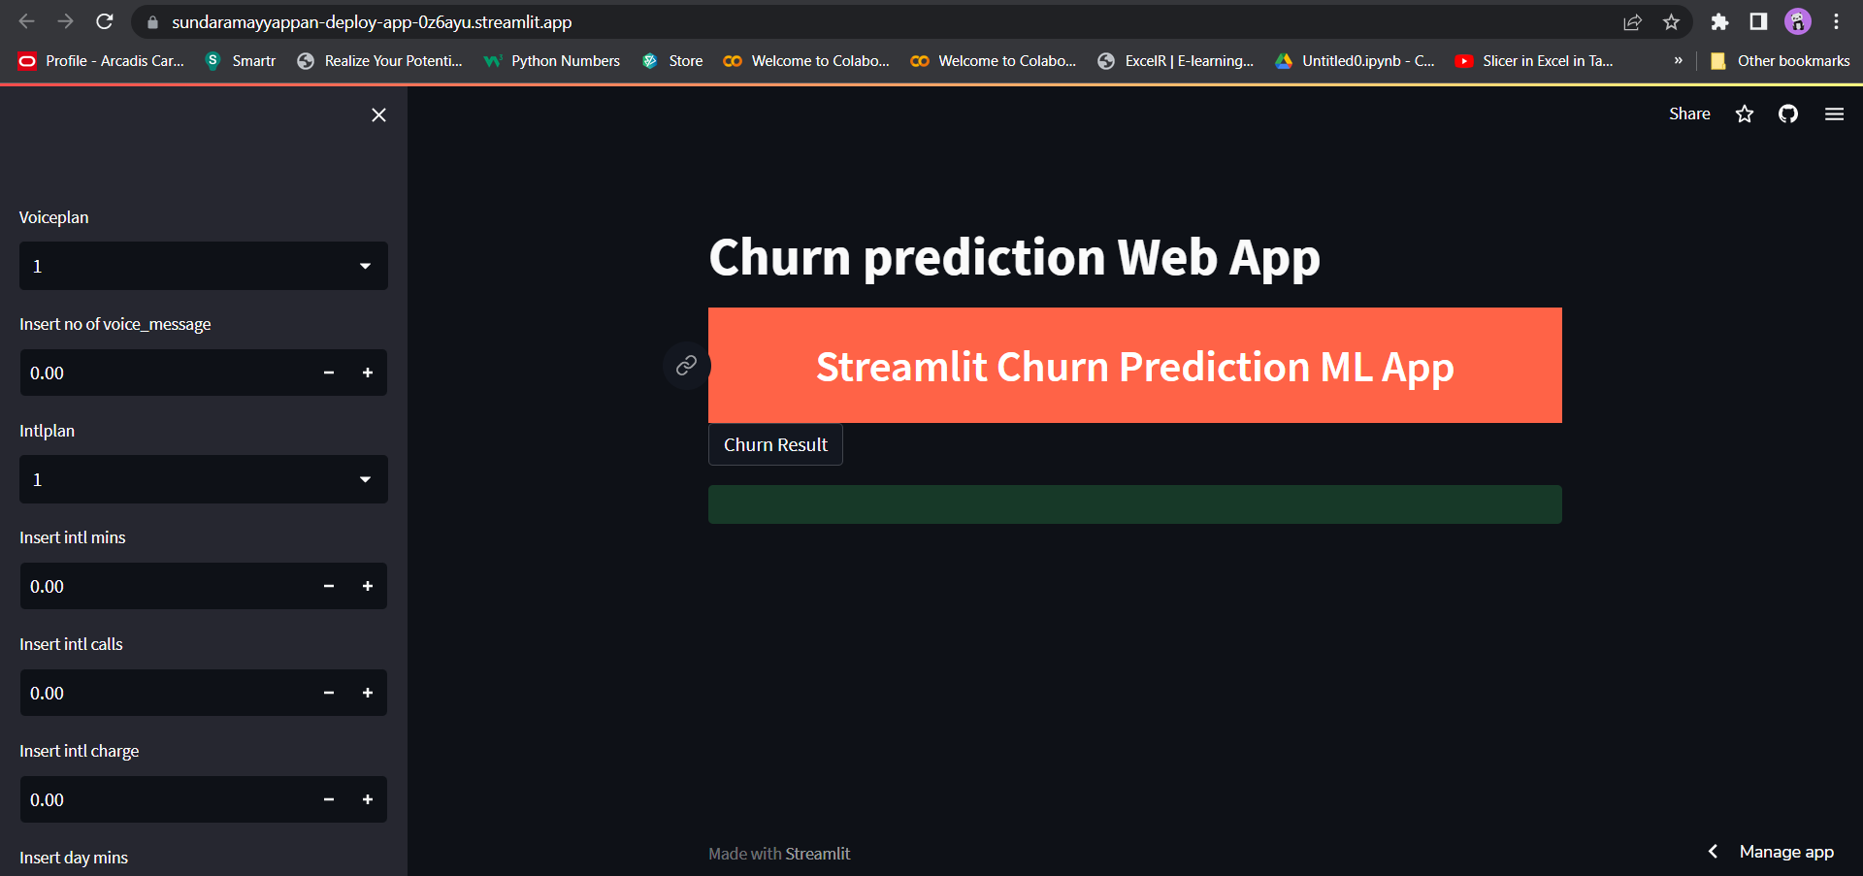
Deployment Link
https://sundaramayyappan-deploy-app-0z6ayu.streamlit.app/

